Slide 1
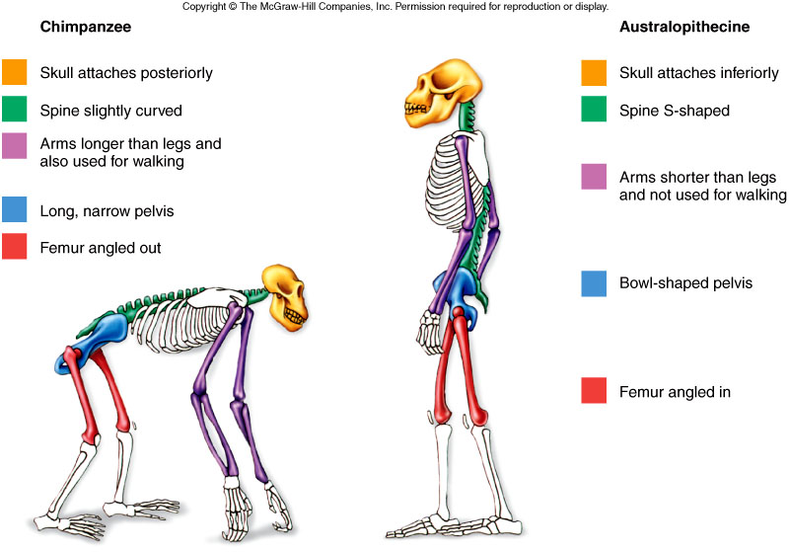
Biology – Human Systems
Fig. 23.5

Slide 2
Introduction
State the characteristics of Humans that classify them into the following groups; Vertebrates, Mammals & Primates
Recognise the differences between, and give examples of, Cells, Tissues, Organs and Systems.
Describe how the human body depends on interacting body systems to meet their needs eg: the circulatory system carries nutrients from the digestive system to the cells via the circulatory system.

Slide 3
1. Levels of Organization (2.30)

Slide 4
Hierarchy of Structural Organisation
Each of these build upon one another to make up the next level:
Chemical level
Cellular
Tissue
Organ
System
Organism

Slide 5
Organisation of an organism
Levels of Organisation
Organism (human)
Organ System
Organs
Tissues
Cells
Organelles
Molecule
Atom

Slide 6
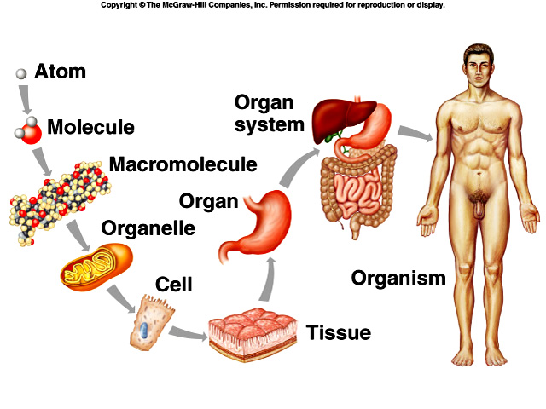
Levels of Organisation:

Slide 7

Hierarchy of Structural Organisation
Chemical level
Atoms are the simplest level.
Atoms combine to make molecules
Macromolecules are large, biologically important molecules inside cells.
4 types of macromolecules in the body;
Carbohydrates
Lipids
Proteins
Nucleic acids

Slide 8
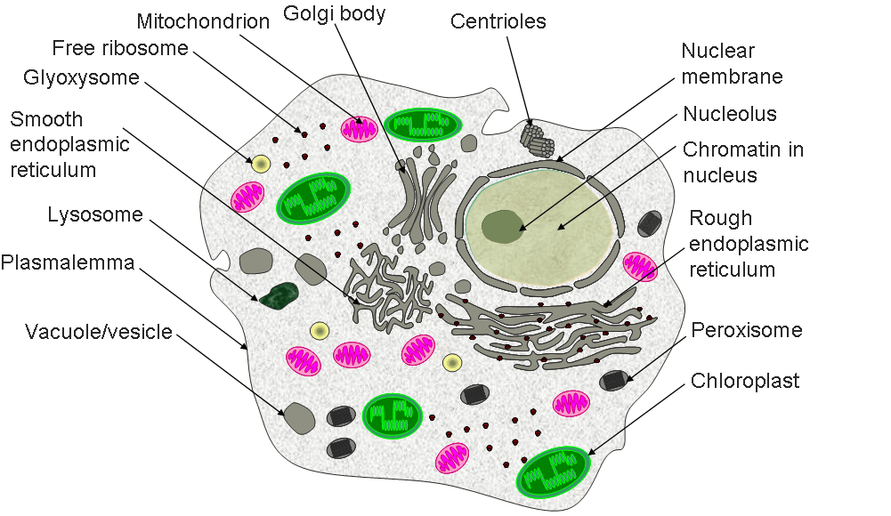
Hierarchy of Structural Organisation
Cellular
Cells are the basic structural and functional unit of living things.
Organelles
Organelles are structures within cells that perform dedicated functions (“small organs”)

Slide 9
Hierarchy of Structural Organisation
A generalised cell can perform all of the functions required for life.
There are very few ‘generalised’ cells in the human body, most have differentiated (change shape / function) to specialise (become good at / concentrate on doing) in a particular function.
This means that most cells rely on other cells to survive.
For example cells in the lining of the lungs are specialised at diffusing oxygen and carbon dioxide but not ‘good’ at movement. Muscle cells in the diaphragm are good at movement but are not designed for rapid diffusion of gases.

Slide 10
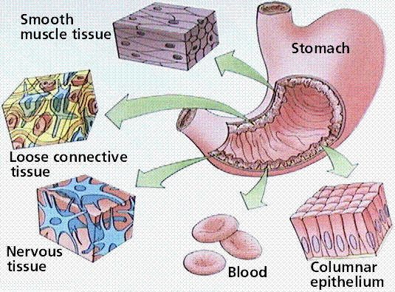
Hierarchy of Structural Organisation
Tissue
A group of cells with a similar size and shape that function together for a common purpose.
4 basic types of tissue in the human body:
Epithelium (skin)
Connective (bone/ cartilage)
Muscle
Nervous

Slide 11
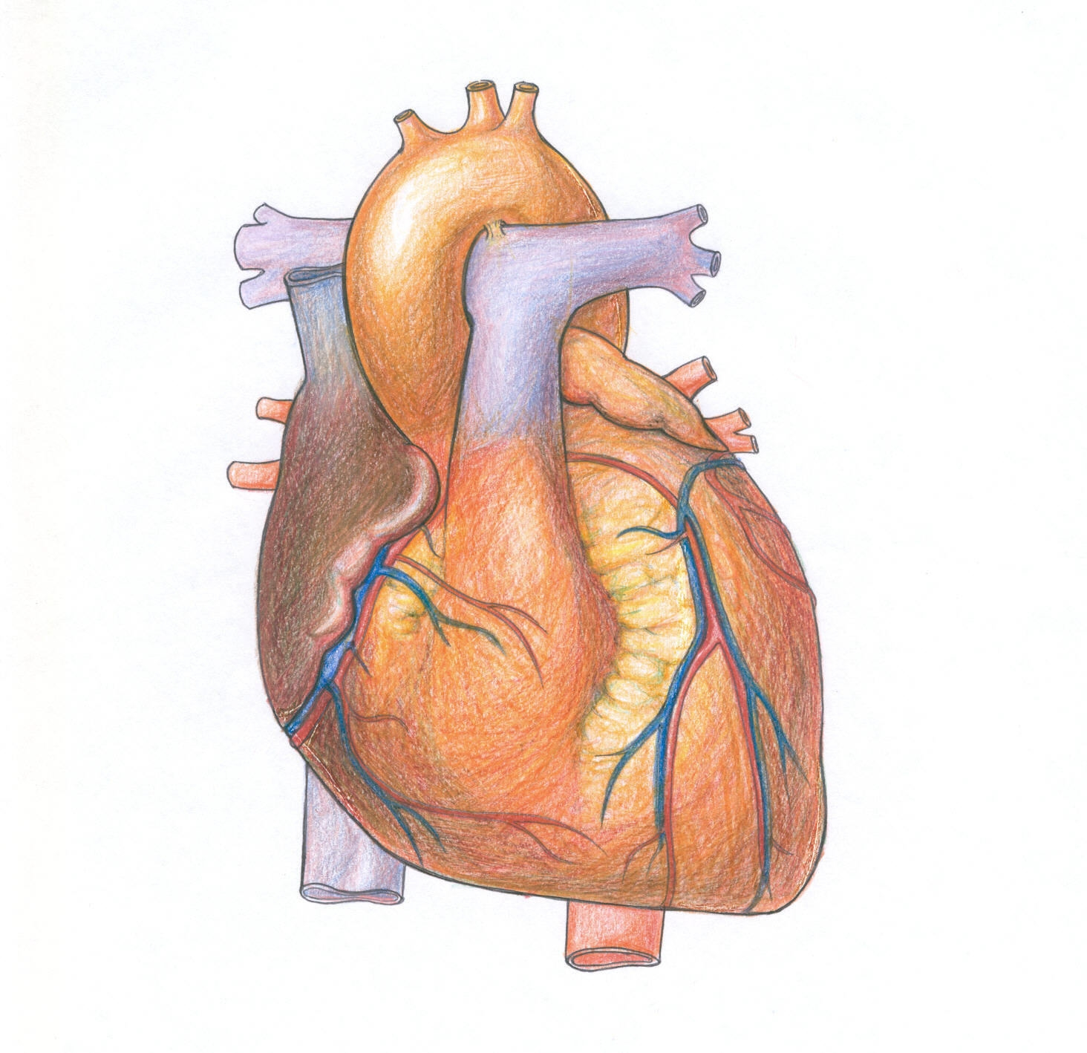
Hierarchy of Structural Organisation
Organ
A structure comprised of two or more tissues that has a definite/specific shape, function and location.
Examples
Heart
Brain
Liver
Pancreas

Slide 12
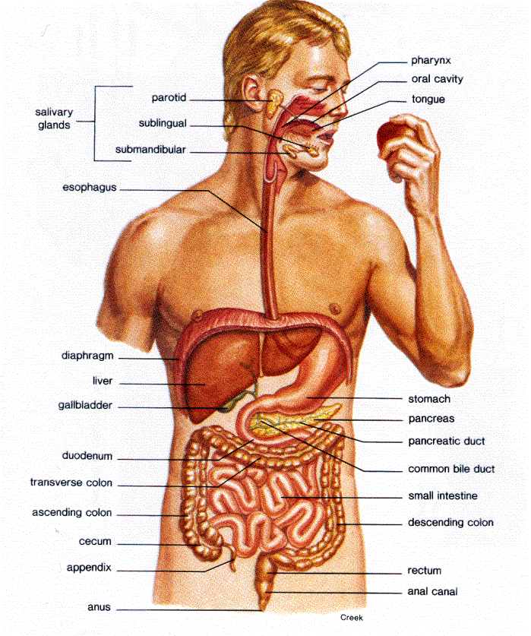
Hierarchy of Structural Organisation
Organ system
A group of organs that function/work together eg coordinated for a common purpose.
Examples
Skeletal
Muscular
Nervous
Circulatory
Respiratory
Digestive
Urinary
Reproductive

Slide 13
2. Human Body Systems The 11 Champions (7.30 min).mp4

Slide 14
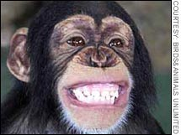
Hierarchy of Structural Organisation
Organism
An individual entity composed of a number of body systems that are coordinated to maintain life.
Population
A group of similar organisms in the same place at the same time.

Slide 15
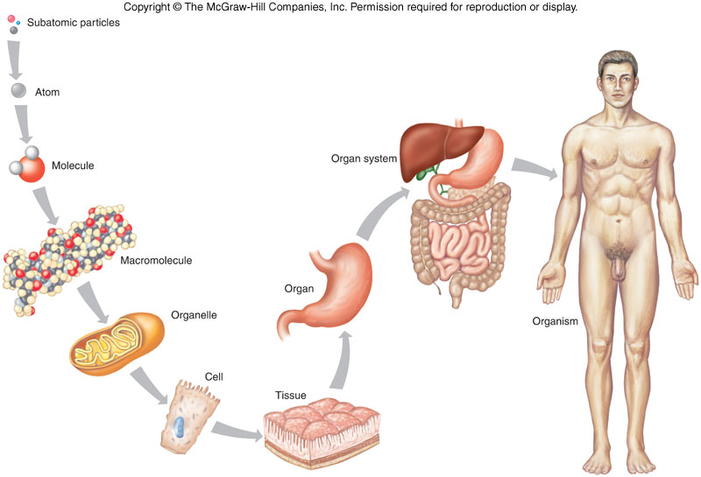
Levels of Organisation

Slide 16
3. Introduction To Anatomy Physiology Levels of Organization (5.00 min).mp4

Slide 17
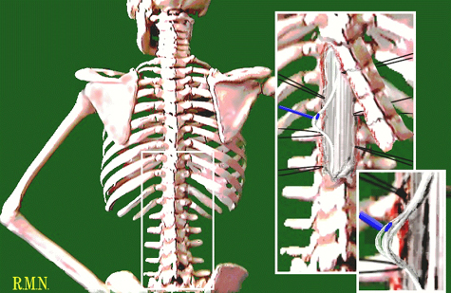
Why are humans classified as Vertebrates?
A backbone.
A dorsal nerve cord

Slide 18
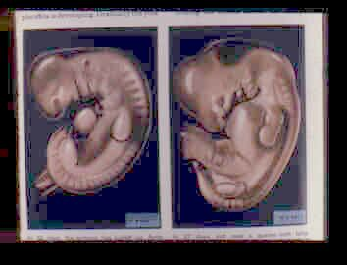
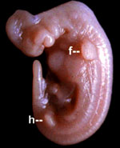
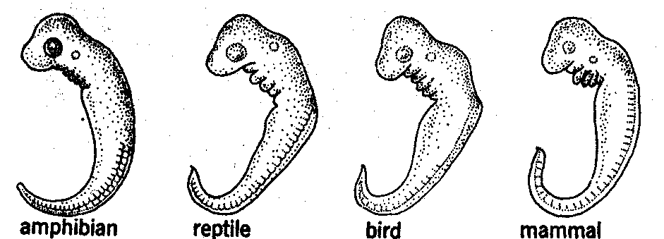
Why are humans classified as Vertebrates?
Gill slits during embryo stage
A post anal tail

Slide 19
4. Highway Of Life From Mammals To Primates (3.00 min).mp4

Slide 20
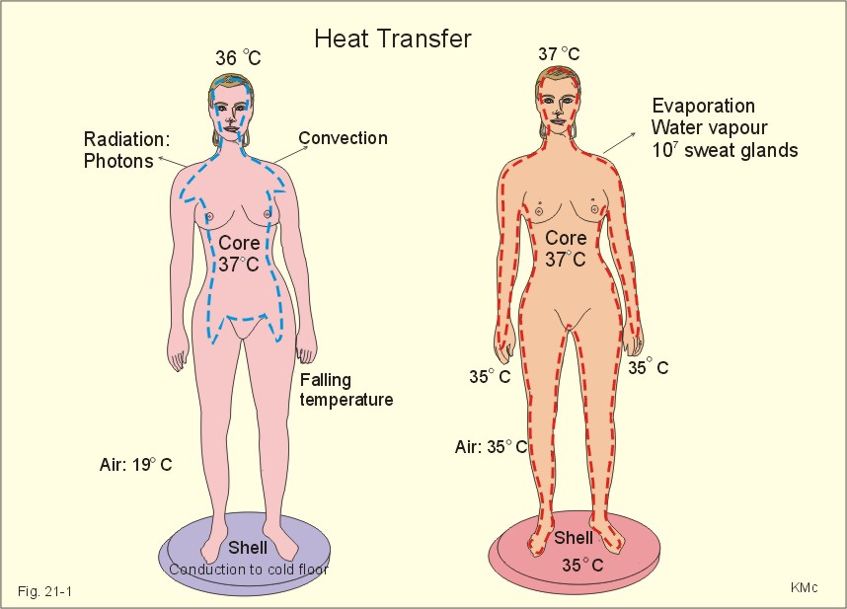
Why are humans classified as Mammals?
Are homeothermic (constant body temperature)

Slide 21
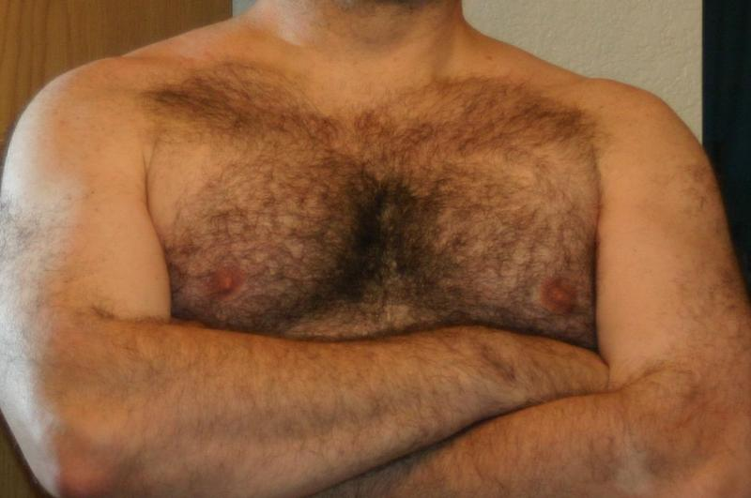
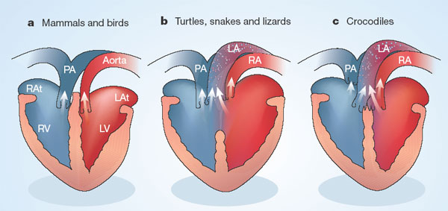
Why are humans classified as Mammals?
Have a four-chambered heart
Have hair on the body

Slide 22
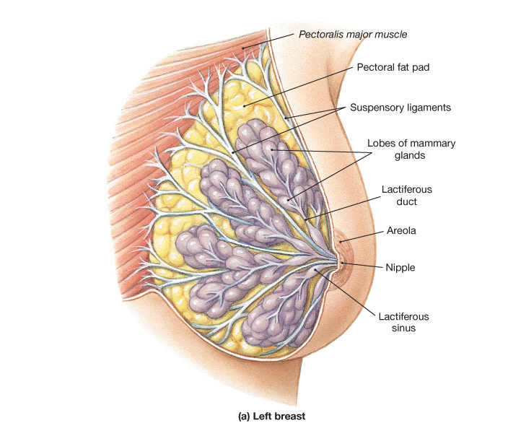
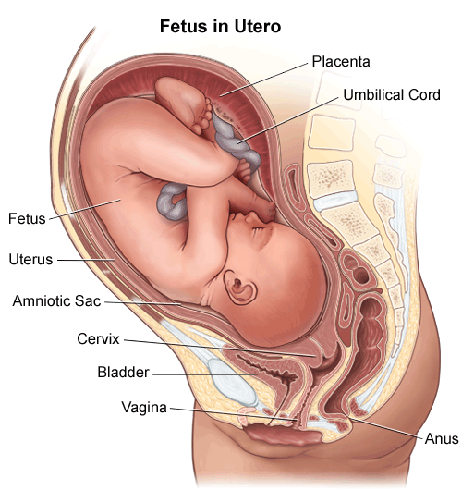
Why are humans classified as Mammals?
Young develop within a uterus.
Females have glands that secrete milk.

Slide 23
5. Primates- What is a Primate (5.00 min)

Slide 24
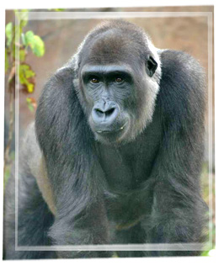
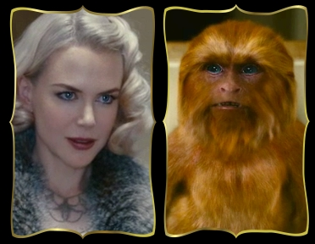
Why are humans classified as Primates?
Have forward-facing eyes

Slide 25
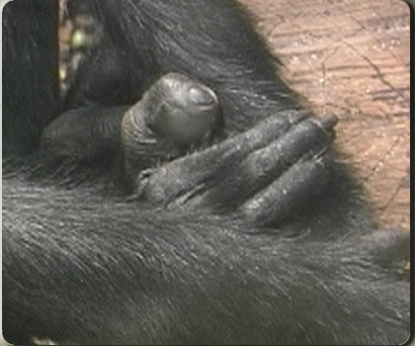
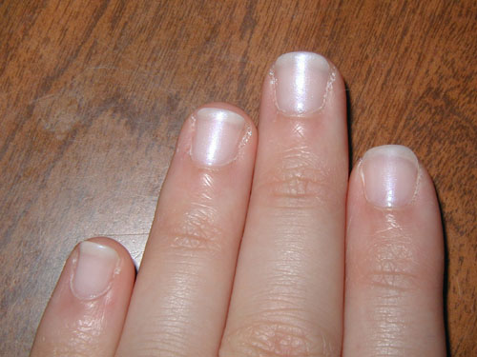
Why are humans classified as Primates?
Have finger nails instead of claws.

